Slide 1
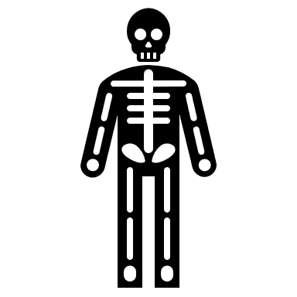
The Skeletal System
GTHBY Human Biology

Slide 2
Review
Name the four lobes of the cerebrum.
Name the two divisions of the PNS, and for each of them, name their two divisions.
Draw the reflex arc, showing a receptor, effector, and three types of neurons.
Explain why the CNS component of the reflex arc uses interneurons in the spinal cord, rather than the brain.

Slide 3
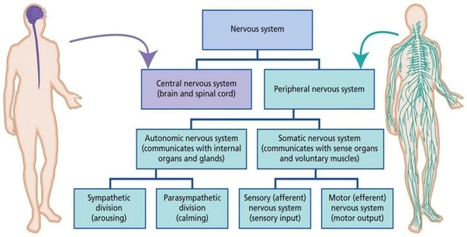

Slide 4
Learning Intentions
The skeleton as the structural framework of the body

Slide 5
Success Criteria
List functions of the Skeletal System
Explain the difference between axial and appendicular skeleton (give examples of bones in each).
Describe the structure of bones
Classify bones by shape

Slide 6
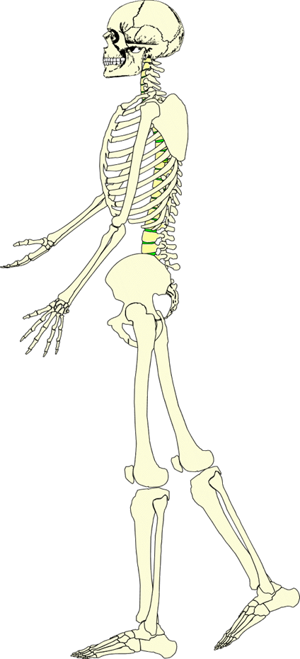
Functions of the skeletal system
1. Protection
The skeleton protects the soft tissue of the body’s organs.
4. Aids in Hearing
The bones in the ears vibrate allowing you to hear.
2. Stores Minerals
The bones store calcium and other minerals required by the body.
5. Blood Production
Red blood cells are made in the ribs and limb bones.
3. Support & Shape
The bones of the body support & give shape to the body.
6. Movement
The bones and joints work with muscles to enable us to walk, run and sprint.

Slide 7
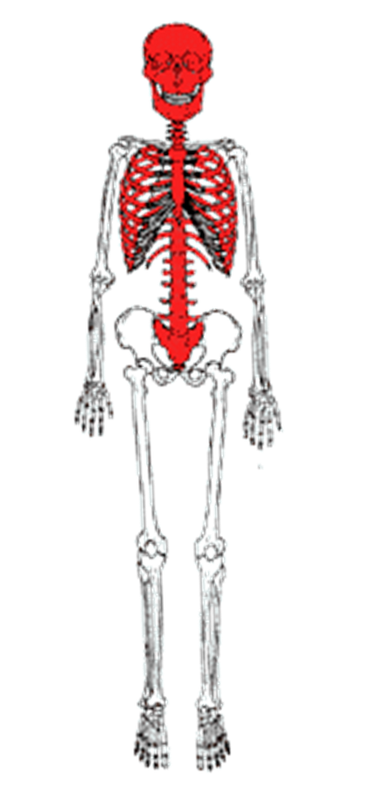
Axial skeleton
Consist of:
Skull
Spine
Ribs
Sternum

Slide 8
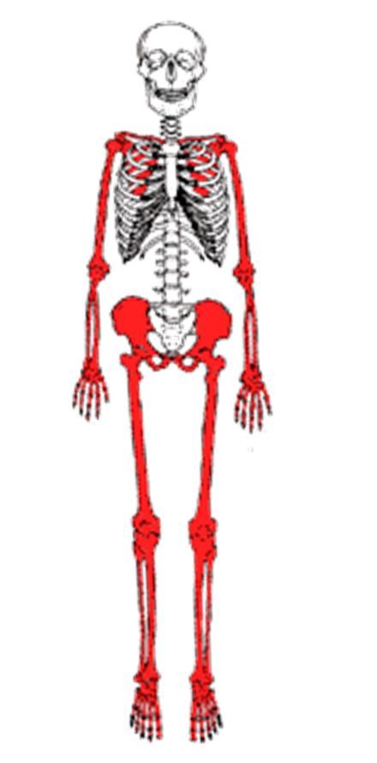
Appendicular skeleton
Consist of the bones that make up the arms and legs (appendages) and girdle, which attach them to the rest of the body.
The pelvic girdle (two hip bones & the sacrum and Coccyx) pectoral girdle (two collarbones) and two scapulas (shoulder blades).

Slide 9
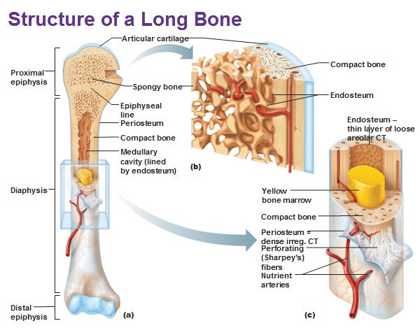
Structure of bones

Slide 10
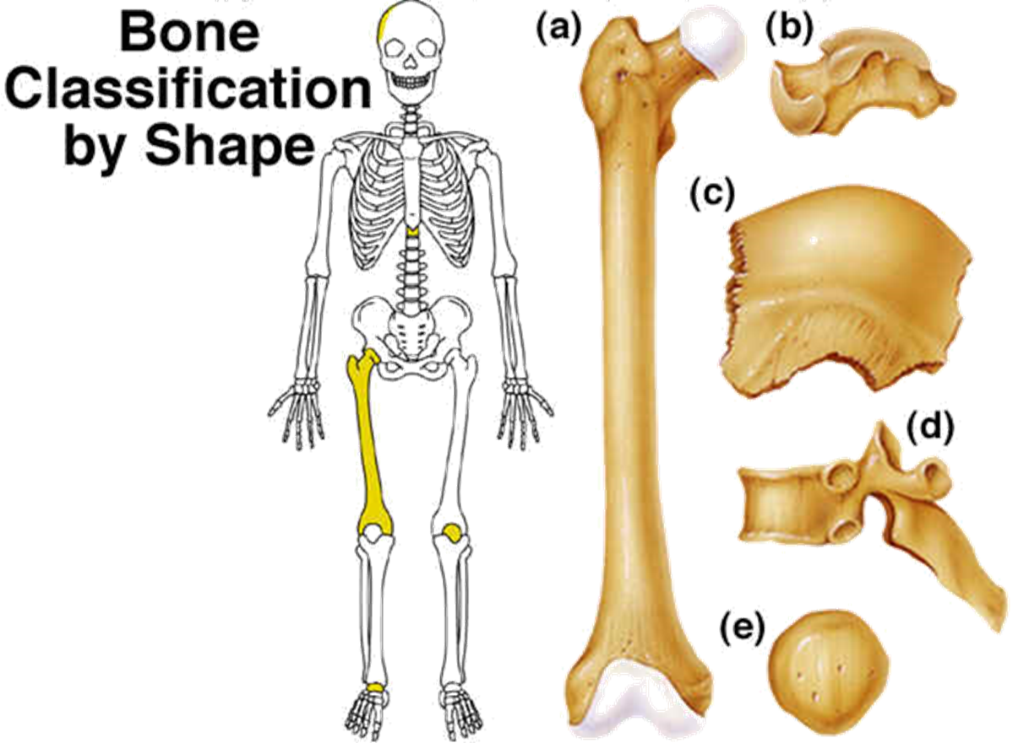
a) Long bones
b) Short bones
c) Flat Bones
d) Irregular bones
e) Sesamoid bones

Slide 11
Bone classification
Long bones – Longer than they are wide. They are found in the arms and legs. The hollow cavity contains marrow where blood cells are produced.
Short bones - Shaped like cubes and are found primarily in the wrist and ankles.
Flat Bones - Thin, flat, and curved. They form the ribs, breastbone, and skull. Main function is to protect organs.
Irregular bones - Different shaped and are not classified as long, short, or flat. They include the hip bones, vertebrae.
Sesamoid bones – Small round bony masses embedded in certain tendons that may be subjected to compression and tension. The largest sesamoid bone is the patella.

Slide 13
Success Criteria
List functions of the Skeletal System
Explain the difference between axial and appendicular skeleton (give examples of bones in each).
Describe the structure of bones
Classify bones by shape

